Slide 1
Modeling Sequential Circuits always Block Assignments

Slide 2
always Block in Sequential Logic
always@(posedge Clock)
always at the positive edge of the clock
always@(negedge Clock)
always at the negative edge of the clock

Slide 3
Blocking and Non-blocking Assignments
Blocking assignments
block the remaining code from executing until a delay has passed
Non-blocking assignments
set up the output to change at a future time, and continue executing the next statements

Slide 4
Blocking and Non-blocking Assignments
Blocking Assignments
ff1 = #3 ff2; // ff1 changes at time 3
ff2 = #3 ~ff1; // ff2 changes at time 6
Non-blocking Assignments
ff1 <= #3 ff2;
ff2 <= #3 ~ff1;
// Both flip-flops change simultaneously at time 3

Slide 5
Blocking and Non-blocking Assignments
Blocking Assignments
count = count + 1;
count = count + 2;
// The result is: count = count + 3
Non-blocking Assignments
count <= count + 1;
count <= count + 2;
// The second statement overrides the first, so: count = count + 2

Slide 6
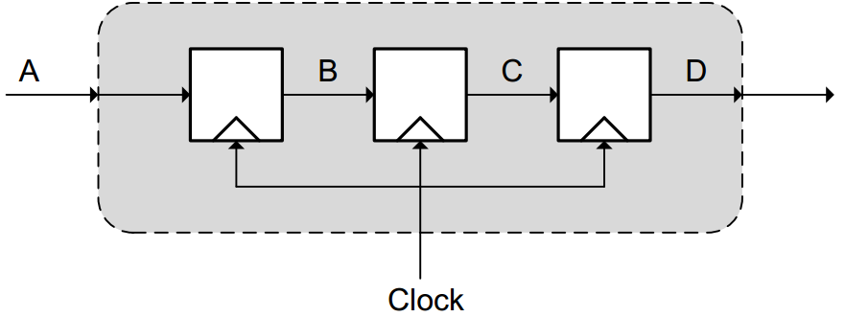
Non-Blocking Assignment
always @ ( posedge Clock ) begin
B <= A ;
C <= B ; // C is set the value of B just before the clock edge
D <= C ;
end

Slide 7
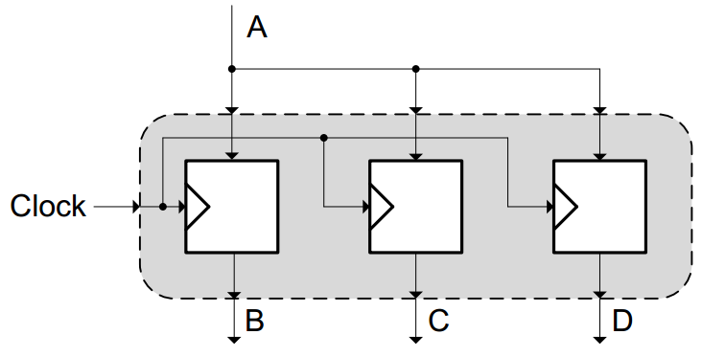
Blocking Assignment
always @ ( posedge Clock ) begin
B = A ;
C = B; // C is set the value of B just after the clock edge i.e. A
D = C ;
end

